Slide 1


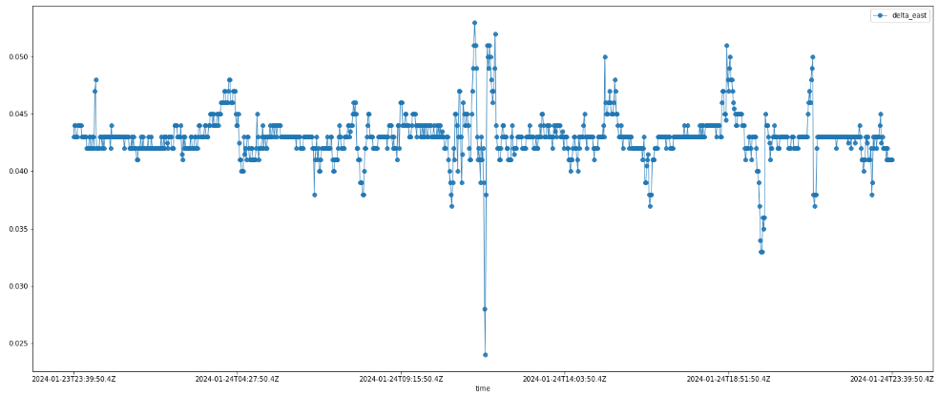






Distributed System and Big Data – A.A. 2023/24 - Unict
Schema progetto (prima parte) di Francesco Pandolfo
VPN
User Interface
get-time-series
8001
8080 /gettimeseries
/query
createQuery_Influxdb
dataframe
JsonRawToJsonDataFrame
8086
/query
users-manager
JSON raw
8002
8080 /consumers
/register
/getall
/{username}
3306
- consumers
- subscriptions
/subscriptions
/register
/getall
/unsubscribe
30sec
processSubscriptions
publish
9092
kafka
notifier
topics:
- station-threshold-mintime
- usersmanager_LOG
- notifier_LOG
subscribeTopics
subscribe
10sec
checkNewSubscriptions
station-threshold-mintime
emailService

